Slide 1
UI/UX Worksheet
Team members
6530262 Min Myint Moh Soe
6530289 Sai Oum Maing
6622085 Min Htet
6520102 Aung Bhone Naing
6530198 Heang Mengtry

Slide 2
Day 4

Slide 3
Assignment: Create affinity map
40 mins
Objective
To understand and be able to create an affinity map of the term project.
Instructions
Use the information from the user interviews to create an affinity map in FigJam application.
Don’t forget to use different colors of stick note for different users.
Insert the picture of affinity map in your worksheet.

Slide 4

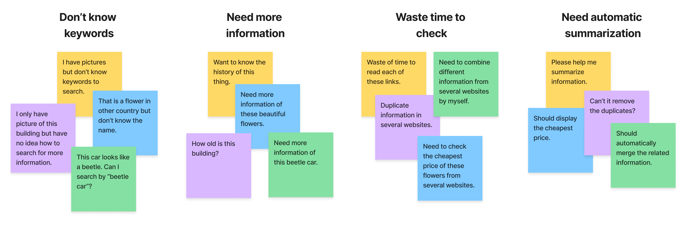
Affinity map (example)

Slide 5
Assignment: Create affinity map
Grading Criteria
0 = Blank
1 = Incomplete or the point in the sticky note is not clearly separated.
2 = Clearly list all the important points in separated sticky notes.
3 = Clearly list all the important points in separated sticky notes, they are grouped, and group names are clear.

Slide 6
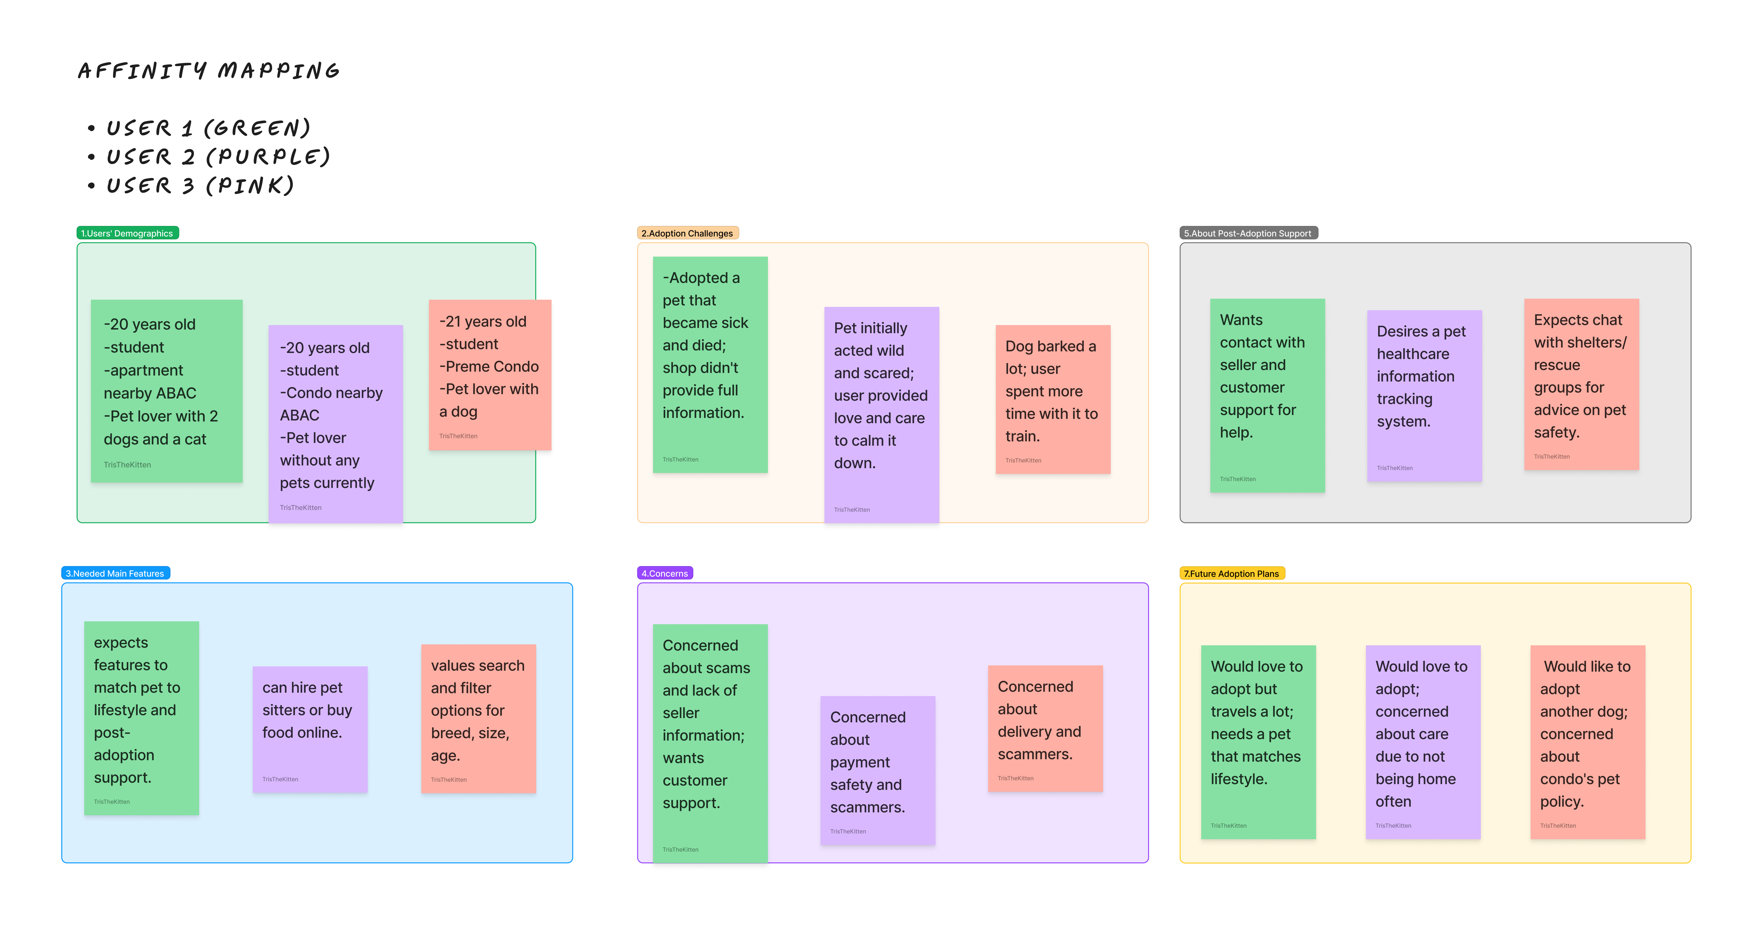
Affinity map
Notes:
(2.5) Group name is not clear. (Cannot read due to small font size). Please try to put only one point per one sticky note (group 2 has more than one point per note).

Slide 7
Assignment: Create user persona
45 mins
Objective
To understand and be able to create a user persona.
Instructions
Use the information from the user research to create a user persona in Figma by using “UXD User Persona Template (ENG).fig” file.
Insert the picture of user persona in your worksheet.

Slide 8
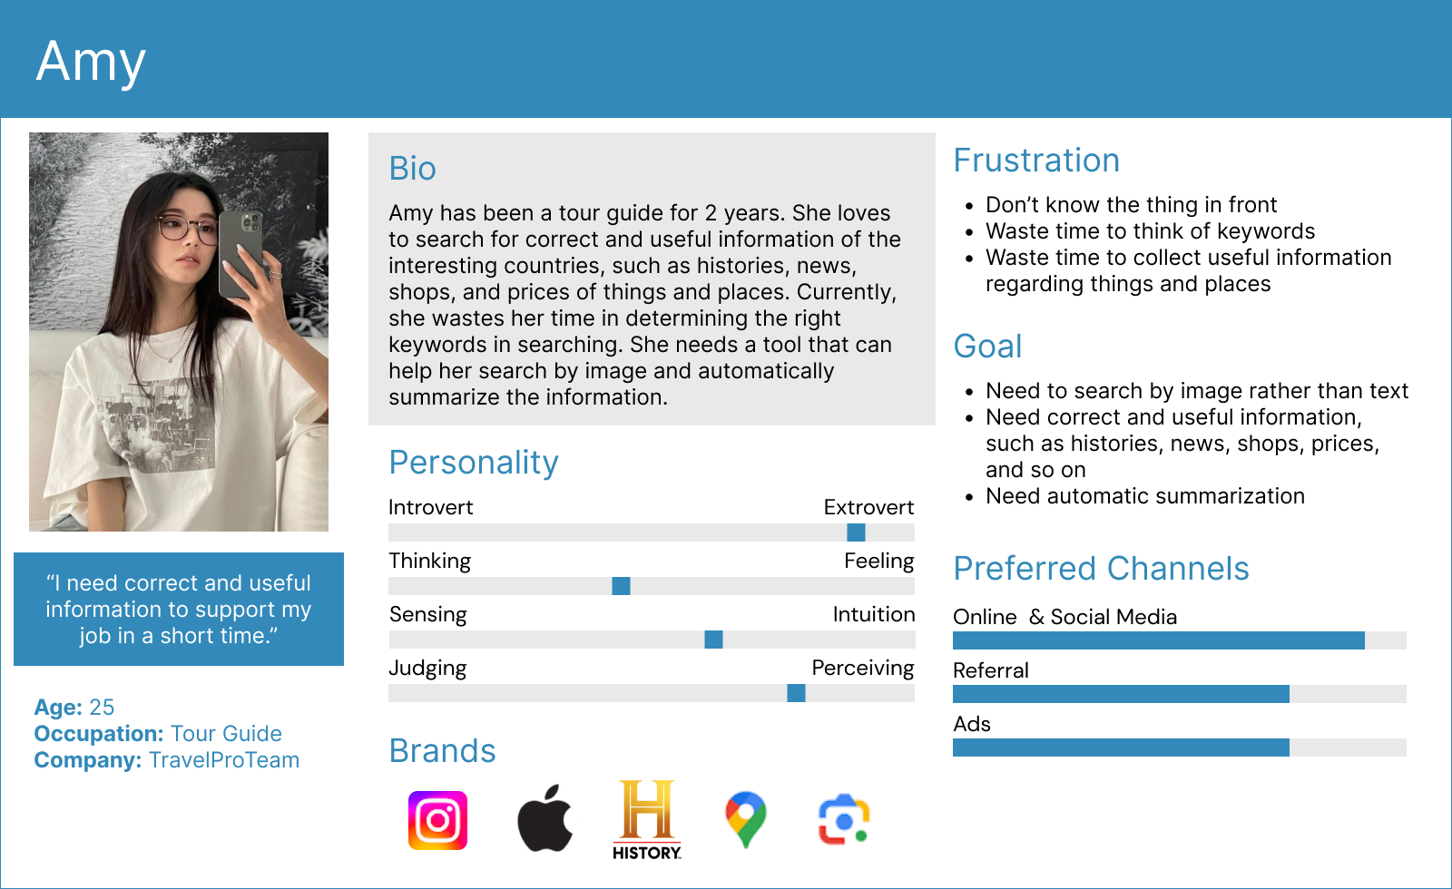
User persona (example)

Slide 9
Assignment: Create user persona
Grading Criteria
0 = Blank
1 = Incomplete
2 = User’s basic information is provided. Goals, frustrations, bio, personality are clearly described.
3 = User’s basic information is provided. Goals, frustrations, bio, personality are clearly described. Other useful information is provided, such as brands, technologies, preferred channels and so on.

Slide 10
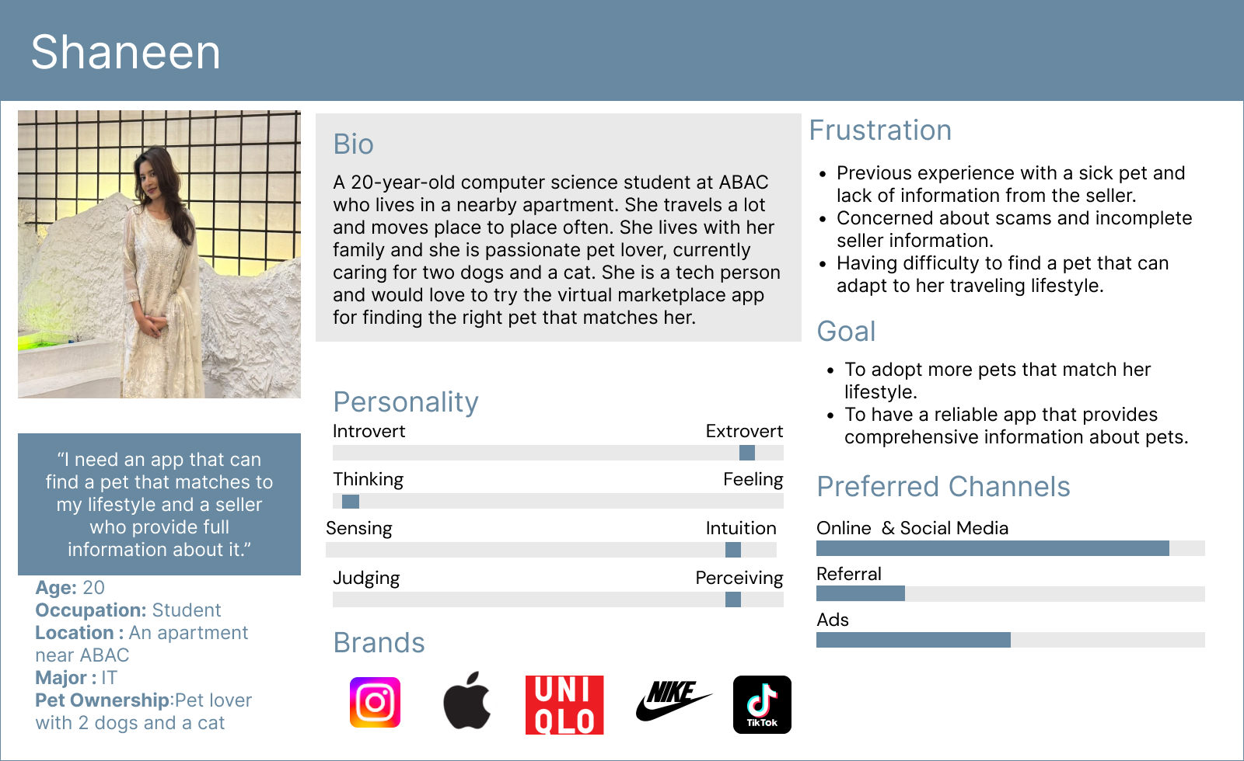
User persona
Notes:
(3) Okay..

